Slide 1

A Study on the Acoustic Signal Based Frameworks for the Real-Time Identification of Geometrically Defective Wire Arc Bead
Notes:
Hi, My name is nowrin Akter Surovi. Today I am presenting a part of my research. The title of today’s talk is

Slide 2
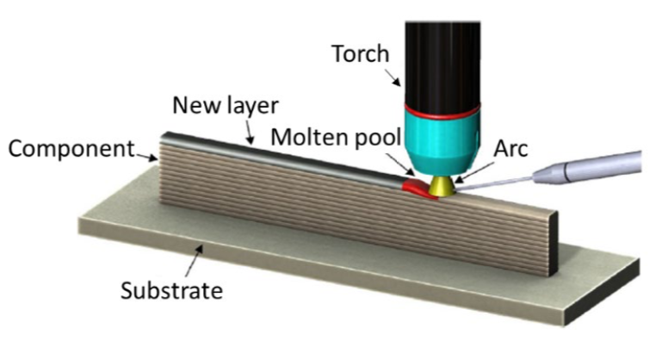
What is Wire Arc Additive Manufacturing (WAAM)?
WAAM is an arc-welding-based Direct Energy Deposition additive manufacturing technique.
Low equipment cost, low buy-to-fly ratio and high deposition rate.
Typical Set up of WAAM
Notes:
Before starting the main part, First we need to know….. Direct Energy Deposition – Step by Step. Material is deposited from the nozzle onto existing surfaces of the object. Material is either provided in wire or powder form. Material is melted using a laser, electron beam or plasma arc upon deposition. the weight of the raw material purchased, compared to the weight of the final part.
WAAM is becoming popular in the metal manufacturing industry because of its low equipment cost, low buy-to-fly ratio and high deposition rate
This is the……… Here electric arc is used as a heat source to melt metal wires. Then the Melted wires are deposited layer by layer to form metallic component on a substrate.

Slide 3
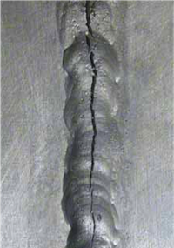
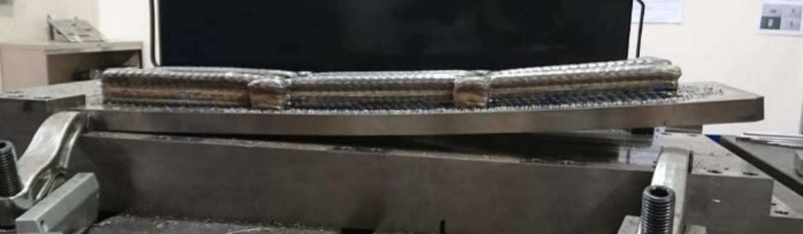
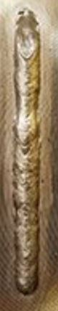
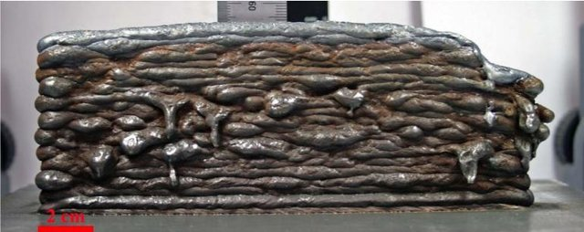
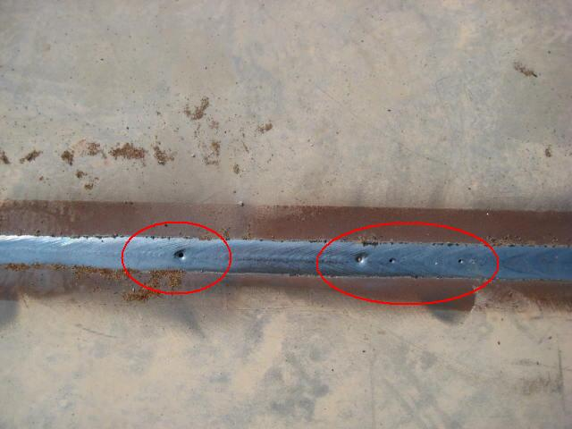
Defects in WAAM
Spatters
Distortion
Cracks
Porosity
Geometric Defects
Oxidation
Notes:
Different kinds of defects can occur during the WAAM process such as

Slide 4
Defects in WAAM
Reasons of Defects
Poor programming strategy
Poor parameter setup
Excessive heat accumulation
Consequence of Defects
Defects affect the overall strength of the WAAM structure
Defect in one layer will affect subsequent layers.
Importance of Defect Detection
Improvement the quality, reliability, and robustness of WAAM products
Reduce of welding cost, man-power, and material waste.
Notes:
In manufacturing industry, The consequence of defects in WAAM is severe because……
The importance of defct detection is crutial for the improvement
Improvement the quality, reliability, and robustness of WAAM products ………..and for the reduction of

Slide 5
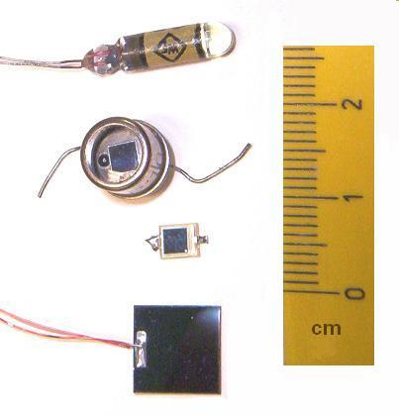
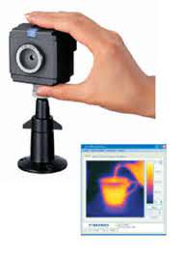
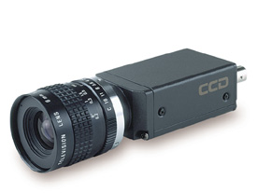
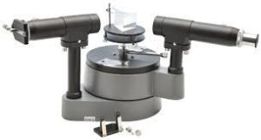
Different Defect Detection Approaches
Thermal measurement
Pyrometer
Thermal camera
Optical Measurement
CCD camera
Photo-diode
Spectrometer
Electromagnetic sensing
Microwave sensor
Photodiode
Thermal camera
CCD camera
Notes:
There are different defect detection approaches people use to identify welding defects.
In thermal measurement approach, Thermal camera and pyrometer are used to monitor thermal condition of WAAM part
Acoustic sensor monitors the intensity of sound from the electric arc in WAAM process.

Slide 6
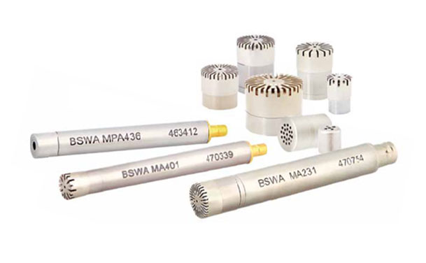
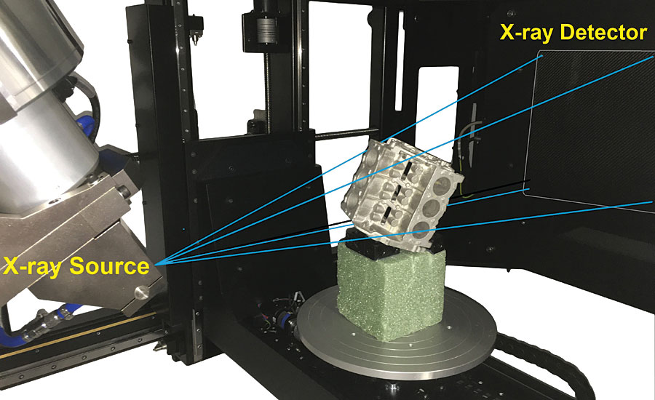
Different Defect Detection Approaches
X-ray Radiation
X-ray CT
X-ray Imaging
Acoustic Signal monitoring
Acoustic sensors
Traditional Sensing
Arc welding current
Arc welding voltage
Acoustic Sensors
X-ray CT
Notes:
In acoustic signal monitoring approach, microphone is used to measure the intensity of sound from the electric arc in WAAM process
X-ray radiation approach ,X-ray CT and X-ray imaging are used in detecting internal defects within the WAAM material

Slide 7
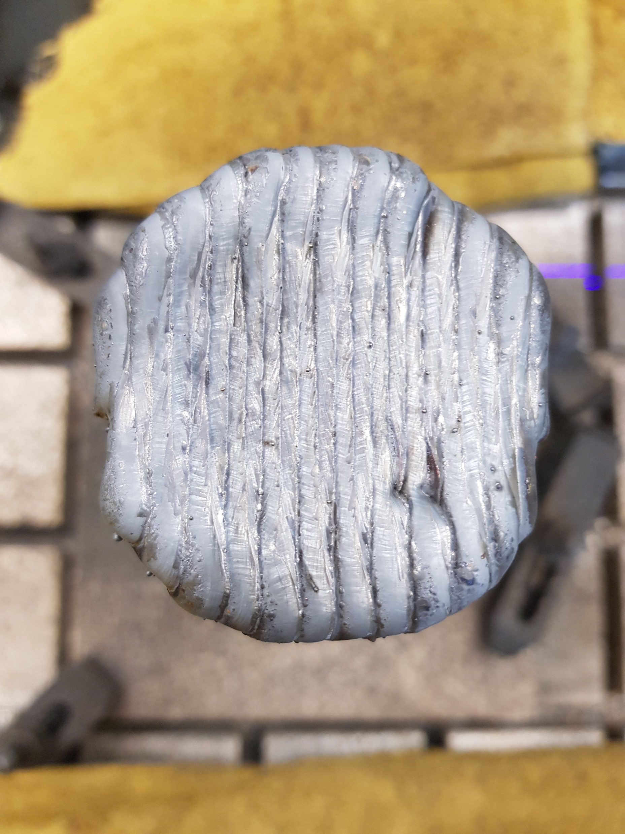
Our Focus
Identifying Geometric Defects
Geometric defects : Non-uniform geometric shape of weld beads
Importance: Voids created by geometrically defective beads will affect the final printed part quality and strength
Using Acoustic Sensors
Advantages: Low cost, easy to maintain and simple structure
Existing approaches: Vision and thermal based sensors are light-sensitive, dust-sensitive, expensive and require high-maintenance
55 mm
Notes:
We focus on two things for today’s talk. They are identifying geometric defects and using acoustic sensors. Geometric defects mean non-uniform geometric shape of weld beads. Geometric defects are important to identify because it creates voids in the final printed product. Geometric defects lead to other kinds of defects. We use an acoustic sensor to identify geometric defects because it is Low-cost, easy to maintain, and simple, whereas the existing approaches such as vision and thermal-based sensors are light-sensitive, dust-sensitive, expensive and require high-maintenance .

Slide 8
Problem Statement
Real-time identification of geometrically defective beads using acoustic sensor
Geometric Defects
Notes:
My problem statement for today’s presentation is to identify geometrically defective beads using an acoustic sensor in real-time

Slide 9
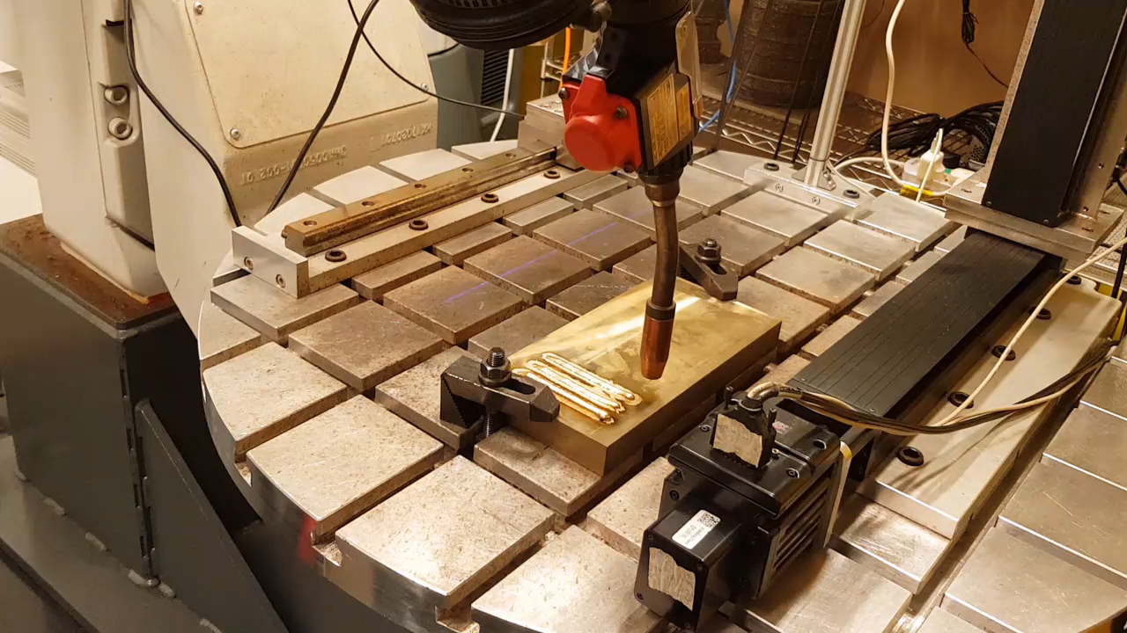
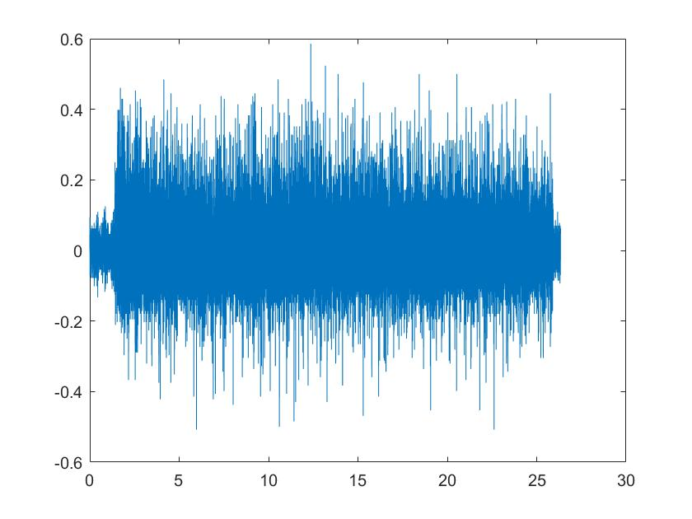
Geometrically Defective Bead Identification
Overview
Down-sampling
Feature Extraction
Predicted
label
Identification
Our Workplace
Acoustic signal
Notes:
This is the overview of our geometrically defective bead identification. After collecting acoustic signal from our workplace, we downsampled our signals because the duration of all acoustic signals is not identical. After downsampling, we get all signals that have the same length. Then we extract features from the downsampled signal, and we make identification to predict labels.

Slide 10
Geometrically Defective Bead Identification
The proposed frameworks
PCA+KNN :
Feature extraction: Principal Component Analysis
Identification: K-Nearest Neighbors
MFCC + NN :
Feature extraction: Mel Frequency Cepstral Coefficients (matrix)
Identification: 3 layer Neural Network
MFCC + CNN :
Feature extraction: Mel Frequency Cepstral Coefficients (image)
Identification: Convolutional Neural Network
Notes:
We proposed three universal frameworks to identify the geometrically defective beads. The first framework is PCA+KNN. Here Principal Component Analysis (PCA) is used for feature extraction, and K-Nearest Neighbors (KNN) is used for identification. The second framework is MFCC + NN, here Mel Frequency Cepstral Coefficients (MFCCs) as features and a Neural Network (NN) used for identification. The third framework is MFCC + CNN. HERE WE convert the MFCCs features into images and use a Convolutional Neural Network (CNN) to identify the defective beads.

Slide 11
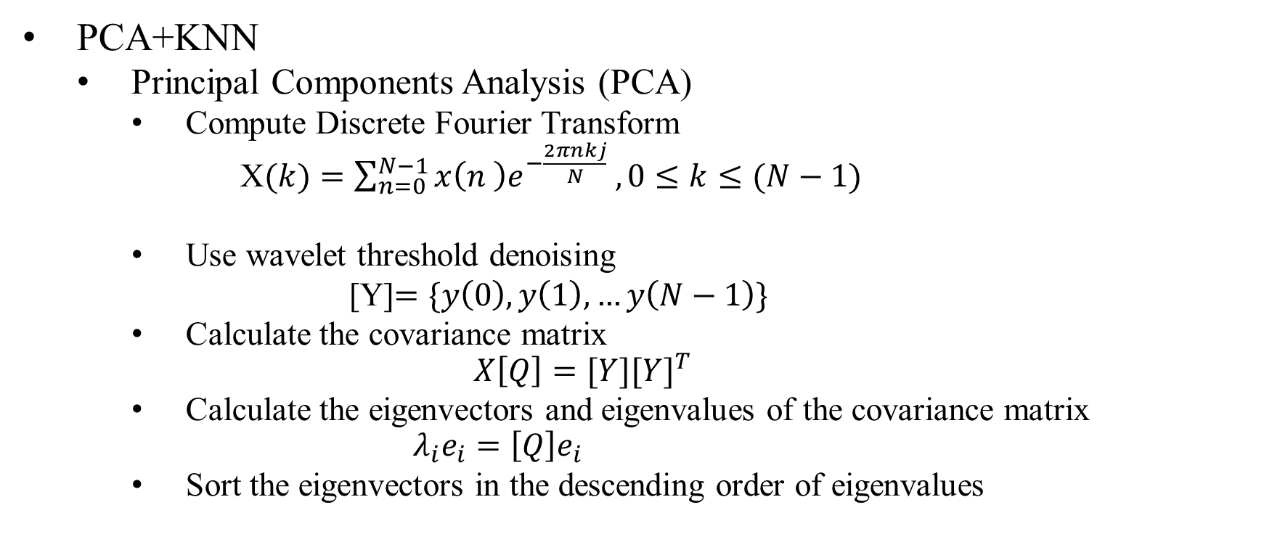
The proposed frameworks
PCA+KNN
Principal Components Analysis (PCA)
Compute Discrete Fourier Transform
X$(k)=\sum_{n=0}^{N−1}{x\left(n \right)e^{−\frac{2πnkj}{N}} , 0≤k≤(N−1)}$
Use wavelet threshold denoising
[Y]$=\{y\left(0\right),y\left(1\right),…y\left(N−1\right)\}$
Calculate the covariance matrix
$$X\left[Q\right]=[Y{][Y]}^{T}$$
Calculate the eigenvectors and eigenvalues of the covariance matrix
$$λ_{i}e_{i}=\left[Q\right]e_{i}$$
Sort the eigenvectors in the descending order of eigenvalues
Notes:
Here I will be discussing about three frameworks. In details.
PCA is a dimension reduction technique. It reduces the dimensions of the data keeping most of the information of the original data. For extract feature , we first ….. on the downsampled signal. 1. where N is the number of points used to compute the DFT
2. to get y(k), and assemble them into a matrix like this
4. $\lambda_i$ is the eigenvalue associated with the eigenvector $e_i$.
5. The eigenvectors with the highest, the second-highest eigenvalues form the $1^{st}$, $2^{nd}$ principal components and so on.

Slide 12
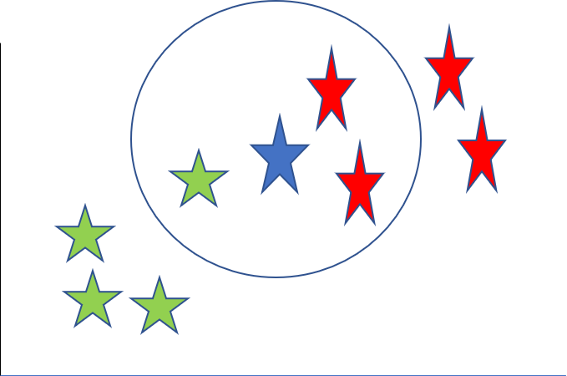
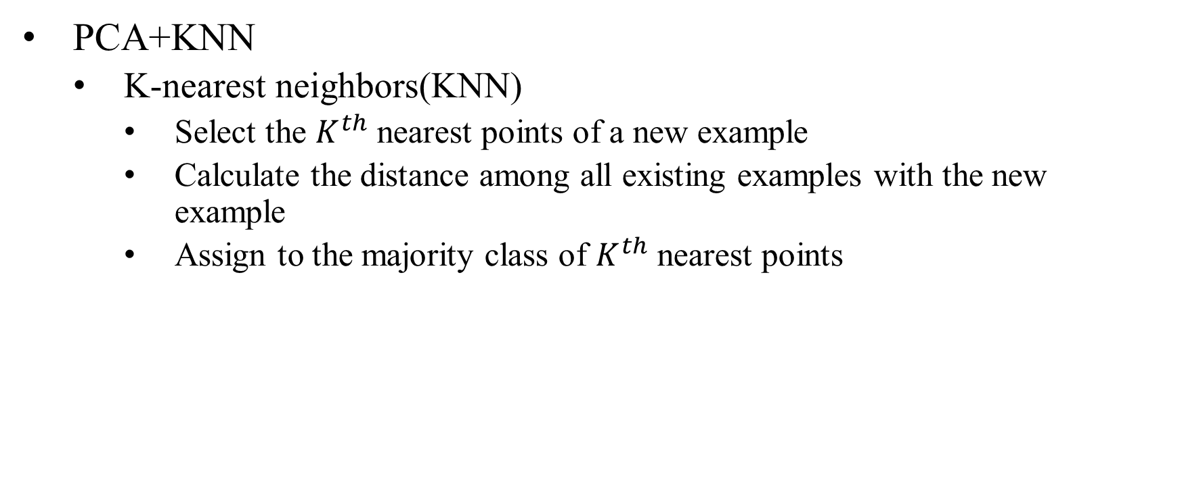
The proposed frameworks
PCA+KNN
K-nearest neighbors(KNN)
Select the $K^{th}$ nearest points of a new example
Calculate the distance among all existing examples with the new example
Assign to the majority class of $K^{th}$ nearest points
Two of three nearest points belong to the class "Red" and one belongs to class “Green“, the new data point will be classified as "Red".
Notes:
KNN is a supervised learning technique.
The algorithm works by selecting the $K^{th}$ nearest points of a new example by calculating the distance among all existing examples with the new example.
2. The $K^{th}$ neighbors are determined by the shortest distance from the new example.
2. The class of new example is assigned to the majority class of $K^{th}$ nearest points.
For example, here are 2 classes. Suppose K=3. the blue is the new example. From this image, you see that………..

Slide 13
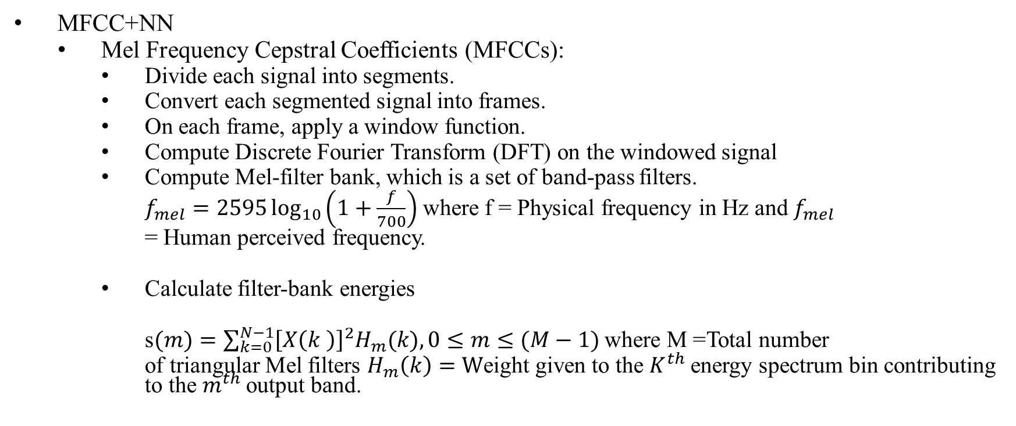
The proposed frameworks
MFCC+NN
Mel Frequency Cepstral Coefficients (MFCCs):
Divide each signal into segments.
Convert each segmented signal into frames.
On each frame, apply a window function.
Compute Discrete Fourier Transform (DFT) on the windowed signal
Compute Mel-filter bank, which is a set of band-pass filters.
$f_{mel}=2595\log_{10}\left(1+\frac{f}{700}\right)$ where f = Physical frequency in Hz and $f_{mel}$
= Human perceived frequency.
Calculate filter-bank energies
s$(m)=\sum_{k=0}^{N−1}{{\left[X\left(k \right)\right]}^{2}H_{m}(k), 0≤m≤(M−1)}$ where M =Total number
of triangular Mel filters $H_{m}\left(k\right)=W$eight given to the $K^{th}$energy spectrum bin contributing to the $m^{th}$output band.
Notes:
So MFCC + NN is the second framework.
0.7 s
10 frames =0.07s/70 ms= frame duration, for each segmented signal
3. (e.g. Hamming window) to get a windowed signal.
4. Most of the filter shape is triangular. The filter-banks are implemented in the frequency domain for MFCCs computation. The conversion of physical frequency to Mel frequency is given :
5. Calculate filter-bank energies by multiplying the square of the magnitude spectrum of DFT signal with each filter-bank
The filter-bank is a nonlinear-scale filter bank that imitates a human’s audible system.

Slide 14
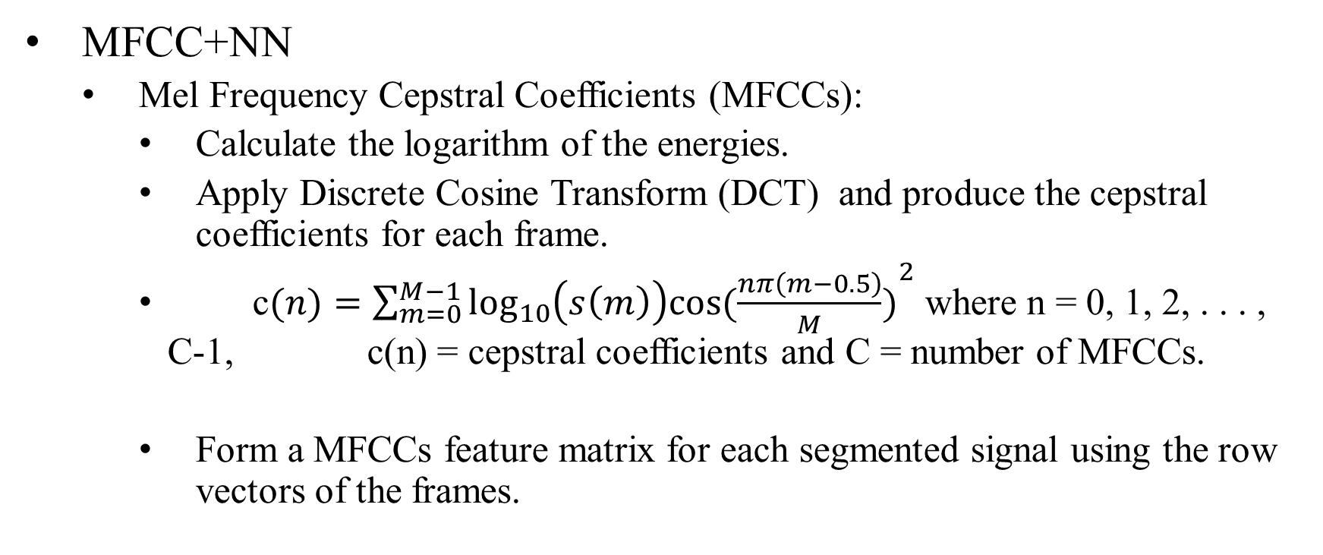
The proposed frameworks
MFCC+NN
Mel Frequency Cepstral Coefficients (MFCCs):
Calculate the logarithm of the energies.
Apply Discrete Cosine Transform (DCT) and produce the cepstral coefficients for each frame.
c$(n)=\sum_{m=0}^{M−1}{{\log_{10}\left(s\left(m\right)\right)cos⁡(\frac{nπ\left(m−0.5\right)}{M})}^{2}}$ where n = 0, 1, 2, . . . , C-1, c(n) = cepstral coefficients and C = number of MFCCs.
Form a MFCCs feature matrix for each segmented signal using the row vectors of the frames.
Notes:
1. Apply Discrete Cosine Transform (DCT) to the log filter bank energies and produce the cepstral coefficients for each frame.
The coefficients of each frame form a row vector. Traditionally, 8 to 13 coefficients are selected.
2. Form a MFCCs feature matrix for each segmented signal because each segmented signal consists of severel frames.

Slide 15
The proposed frameworks
MFCC+NN
NN
Inputs = the MFCCs feature matrices of all segmented signals.
Notes:
So this is the architechture of my proposed NN consists of one input layer, three hidden layers and one output layer. The hidden layers contain 512, 256 and 64 neurons, respectively. Rectified Linear Unit (ReLU) activation functionis used in all hidden layers. L_{2} regularization (0.001) is used in every hidden layer to avoid overfitting problem.

Slide 16
The proposed frameworks
MFCC+CNN
MFCCs
Extract MFCCs feature matrix of a segmented signal
Convert each MFCCs feature matrix of a segmented signal into an image
Notes:
In last framework, I use MFCCS feature images for training Convolution Neural Network(CNN), I first ……………similar as in MFCC+NN framework.
I refer this image as MFCCs feature image. An example of MFCCs feature image shows here

Slide 17
The proposed frameworks
MFCC+CNN
CNN
Inputs = the MFCCs feature images of all segmented signals.
Notes:
The architecture of our CNN is given in Figure
Our proposed CNN is made up of two convolutional layers, two pooling layers, one fully connected layer, and one output layer. Each convolutional layer consists of 32 filters, and the size of each filter is 3 by3. each max-pooling layer filter size is $3 \times 3$. The Fully Connected (FC) layer contains 64 neurons to connect all the activation of previous layers. One dropout (0.3) is added after the FC layer to avoid overfitting. Strides 2 by 2

Slide 18
Experimental Setup and Data Collection
Experimental setup:
Printed 26 bronze and 52 stainless
steel beads.
Varied torch speed and wire feed
rate to print beads of different
qualities.
Data collection:
Collected acoustic signals during
the welding process at 8000 Hz
Divided each signal into 10 non-overlapping segments of equal duration:
260 bronze signal segments
520 stainless steel signal segments
Notes:
The is the picture of our experimental set-up. Using this set-up, we printed 26 bronze and 52 stainless steel beads in our lab. We varied torch speed and wire feed rate to print beads of different qualities. We collected acoustic signals during welding at 8000 Hz. Then we divide each signal into ten non-overlapping segments of equal duration. So we get 260 bronze signal segments and 520 stainless steel signal segments.

Slide 19
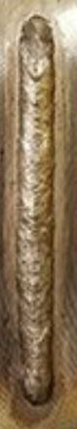
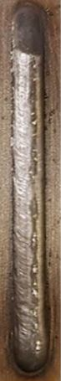
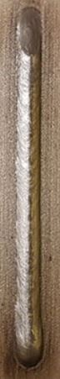
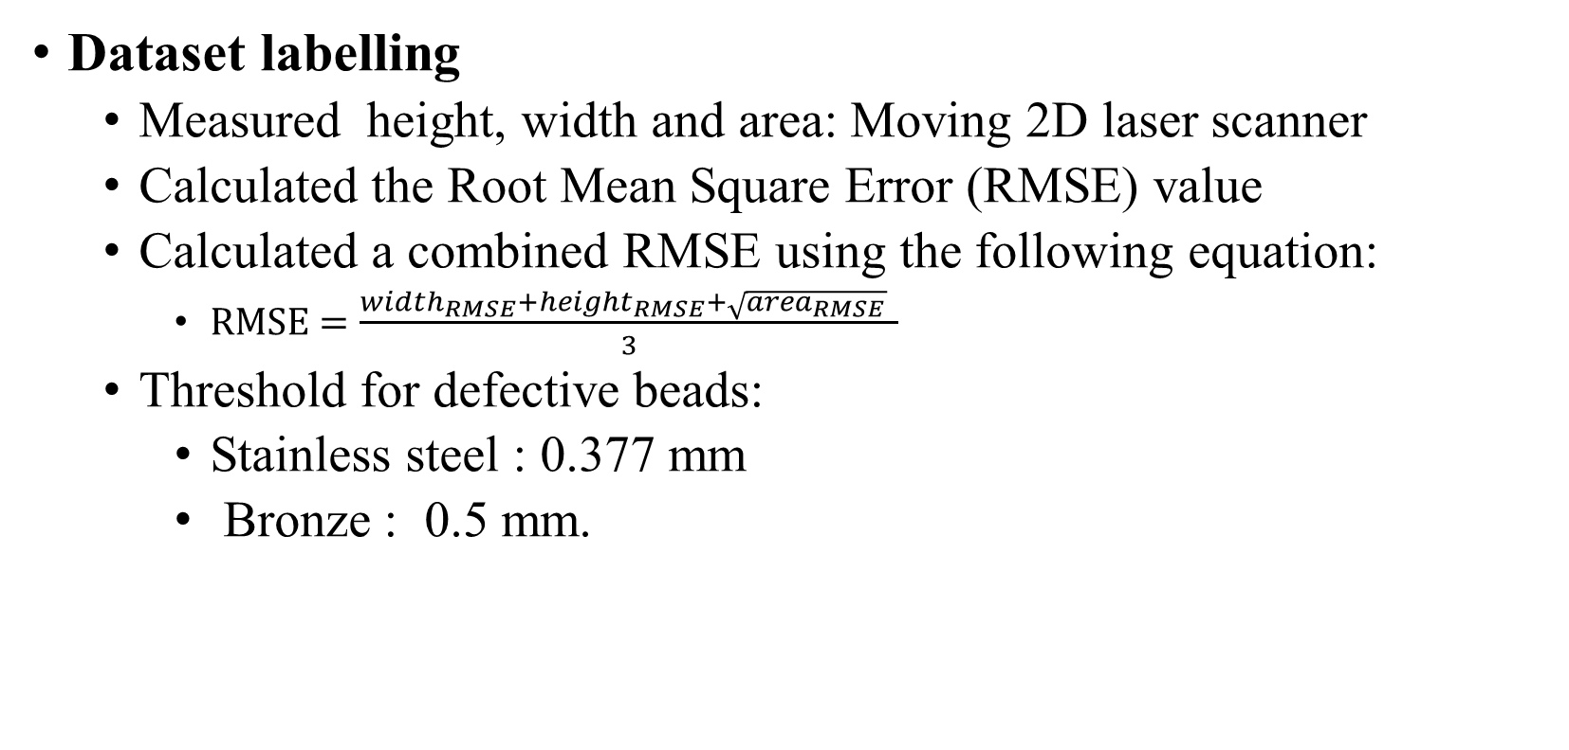
Training Frameworks
Dataset labelling
Measured height, width and area: Moving 2D laser scanner
Calculated the Root Mean Square Error (RMSE) value
Calculated a combined RMSE using the following equation:
$RMSE=\frac{width_{RMSE}+height_{RMSE}+\sqrt{area_{RMSE}} }{3}$
Threshold for defective beads:
Stainless steel : 0.377 mm
Bronze : 0.5 mm.
Material | Defective Beads | Non-Defective Beads
Bronze
Stainless Steel
Geometric defects
Notes:
We trained our frameworks to predict labels. For doing that, first, we need to label our datasets. For labelling our dataset, we measured the height, width and area of each bead using a moving 2D laser scanner. Then we calculated the Root Mean Square Error (RMSE) value of height, width and area of each bead. Then we calculated a combined RMSE using this equation. We set 2 thresholds based on observation and fine-tuning for two materials for defective beads. For SS, the threshold is 0.377 mm, and for B, the threshold is 0.5 mm. This is an illustration of defective and non-defective B and S beads based on our thresholds.

Slide 20
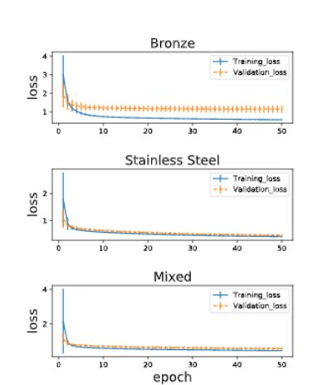
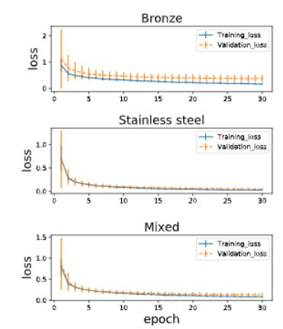
Training Frameworks
Training mechanism
60% for training, 25% for testing and 15% for validation
For training KNN, we use 1st six principal components.
For training NN, we run 50 iterations for each training and validation
For training CNN, we run 30 iterations for each training and validation.
Train all 30 times
.
Notes:
After labelling our datasets, we trained our frameworks. To do so, We divided all datasets randomly as 60% for training, 25% for testing and 15% for validation. For training KNN, we use 1st six principal components because using 1st six components to train KKN give the highest mean validation accuracy. We run 50 iterations for training and validation NN because, after 50 iterations, both training and validation loss become stable with a minimum gap. For training CNN, we run 30 iterations for each training and validation because of the similar reason in the case of NN. Then we train all our identifiers 30 times to check their stability.
Adam optimizer with sparse categorical cross-entropy loss (learning rate=0.0001)

Slide 21
Results
Comparative Evaluation (accuracy) : The performance of our frameworks based on testing accuracy
Accuracy of our frameworks and existing approach (ANN)
Notes:
After training our frameworks, we evaluate the performance of our frameworks based on testing accuracy. We compare our frameworks with the existing approach ANN. From the bar chart, we see that all our proposed frameworks outperform the ANN framework largely. Furthermore, we observe that among our frameworks, PCA+KNN shows the highest accuracy for all datasets.

Slide 22
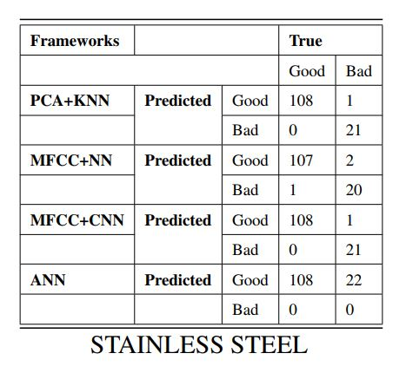
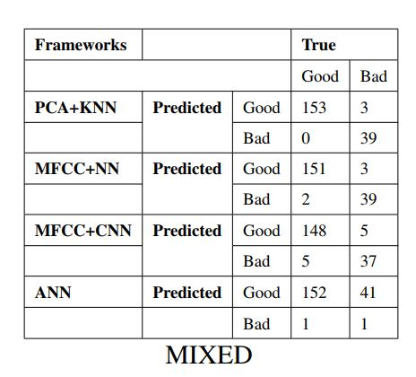
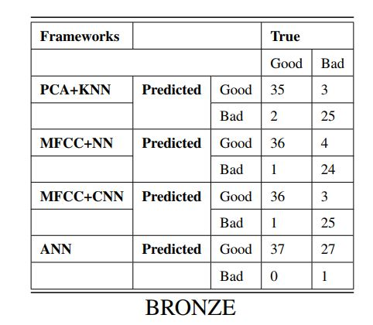
Results
Comparative Evaluation (Confusion matrix) : The performance of our frameworks with imbalanced datasets.
Confusion matrix of our frameworks and existing approach (ANN)
Notes:
Our datasets are imbalanced. Because the number of defective and non-defective beads is not the same. We calculate the confusion matrix because we can see both true and predicted values from the confusion matrix. So, it measures the quality of a framework with an imbalanced dataset. From the three tables, we see that our proposed frameworks can pick out good and bad segments effectively. In comparison, the existing ANN framework wrongly identifies a bad bead as a good bead. So we say that our frameworks perform well with an imbalanced dataset.We also measure F1 score, precision, recall to evaluate our frameworks with our imbalanced datasets. If you are interested, you can go to our paper to see the results.

Slide 23
Results
Comparative Evaluation (Robustness): The performance of our frameworks with mislabelled datasets
Robustness of our frameworks w.r.t training set mislabelling
Notes:
Since our labelling is based on human perception, it is important to evaluate the robustness of our frameworks w.r.t training set mislabelling. From the picture, we see that Even if we mislabel 50 % of training data, the accuracy of our frameworks do not degrade much. Overall, MFCC+CNN is the most robust framework.

Slide 24
Summary
Objective: Defective beads identification early in real-time that could save welding resources and material costs.
Three universal frameworks: PCA+KNN, MFCC+NN and MFCC+CNN
Our frameworks vs ANN (Pernambuco et al.): Ours’ outperform by at least 30% on mixed data-sets.
Testing accuracy of our frameworks :
Above 90 % on mixed datasets.
Best performing framework is PCA+KNN: 96.39 % on mixed data-sets
Notes:
To summarize, we recall our objective is to identify defective beads early in real-time to save welding resources and material costs.To do so, we proposed three frameworks. Our frameworks outperform the existing ANN approach by at least 30% on mixed data sets. The testing accuracy of all our frameworks is above 90 % on the mixed dataset. Our best-performing frameworks PCA+KNN achieves a 96 % accuracy on mixed datasets.

Slide 25
Summary
Confusion matrix of our frameworks: Pick out good and bad segments effectively than existing ANN
Robustness of our frameworks:
All robust with respect to training data mislabelling
Best performing framework is MFCC+CNN: 50% mislabeled (training) => Loss of accuracy (7%)
Notes:
From the confusion matrix, we see that our frameworks can pick out good and bad segments effectively than existing ANN. All of our frameworks are robust with respect to training data mislabelling. Our most robust framework is MFCC+CNN. It losses only 7 % original accuracy when we mislabel 50 % of training data.

Slide 26
Thank You
Notes:
We have come to the end of the presentation. Thank you, everyone, for the attention. If u have any question ,feel free to ask me.
We r open for q and a right now.

Slide 27
Supplementary slides

Slide 28
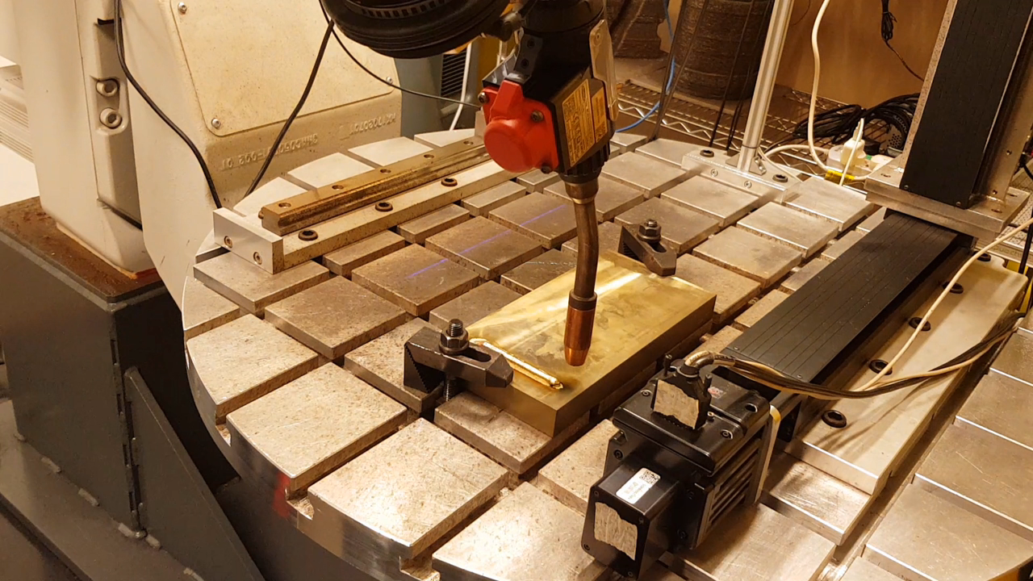
Experiment

Slide 29
Introduction Related Work Propose Research Preliminary Results Further Direction Q&A
Different Defect Detection Approaches
Approaches | Disadvantages
Thermal Measurement | Rugged , expensive and dust-sensitive
Optical Measurement | Optical distortion, light sensitivity and poor stability
X-ray Radiation | Time consuming and Hard to install
 | Possibility to expose of high risk radiation
Electromagnetic sensing | Examination of large parts may require use of equipment with special power requirements
Acoustic Signal Monitoring | Background Noise sensitive
Traditional Sensing | Related to machine condition, not associated with the part condition or environmental condition.
Notes:
There are many disadvantages of existing approaches such as thermal sensors are rugged and expensive. Accuracy of the devices may be affected
by dust, smoke and thermal radiation.
2. Optical sensors like CCD camera Physically small and can image only small parts of WAAM product. In Spectrometer and photodiode, optical distortions may create Optical distortion creates false reading from the device
……... They have light sensitivity and poor stability , they require high-maintenance.
3. X-ray radiation like X-ray CT and X-ray imaging are expensive and long time to take defect detection. Hard to install due to its complicated structure. They have high Possibility to expose high risk radiation. So, strict safety precaution should be taken in this approach.
4, create disturbance for defect detection.
4. Asoustic approach is sensitive to background noise

Slide 30
Introduction Related Work Propose Research Preliminary Results Further Direction Q&A
Defects in WAAM
Distortion : Shrinkage or bending of the WAAM product
Excessive heat input
Spatters: Weld metal droplets that expelled from weld pool
Incorrect weld parameters
Cracks: A line in the WAAM product which contributes to premature failure
Incorrect choice of weld metal, high welding speed with low current etc.
Causes of joint injury.
1) Sport injuries.
2) Osteoarthritis
3) Other types of disease
(Example: Gout)
Spatters
Distortion
Cracks
Notes:
Sometimes, imperfections or irregularities occur in WAAM process. Unacceptable imperfections is called defects.
Different defects occur during welding process, for instance
1, Distortion refers to the shrinkage or bending of the WAAM product, and it occurs due to excessive heat input
2. refer to weld metal droplets that expelled from weld pool and it occurs due to incorrect weld parameters.
3, Cracks refer to a line in the WAAM product which contributes to premature failure, and it occurs due to incorrect choice of weld metal, high welding speed with low current, poor joint design etc.
4, Oxidation refers to the oxide films trapped within the weld metal, and it occurs due to oxygen in shield gas, poor gas shielding etc
5.Porosity refers to the voids in WAAM product, and it occurs due to weld metal contamination, presence of moisture, grease or oil etc.
6,Geometric defects refer to the misshapen and incorrect weld size and it occurs due to poor welding technique and usage of incorrect weld parameters etc.
Lack of fusion refers to the poor fusion of the weld bead to the surface of a base plate, and it occurs due to too low current, too high travel speed, incorrect torch angle etc.

Slide 31
Introduction Related Work Propose Research Preliminary Results Further Direction Q&A
Defects in WAAM
Oxidation: Oxide films trapped within the weld metal
Oxygen in shield gas, poor gas shielding
Porosity : Voids in WAAM product
Weld metal contamination, presence of moisture, grease.
Geometric defects : Misshapen and incorrect weld size
Poor welding technique and usage of incorrect weld parameters
Causes of joint injury.
1) Sport injuries.
2) Osteoarthritis
3) Other types of disease
(Example: Gout)
Porosity
Geometric Defects
Oxidation
Notes:
Sometimes, imperfections or irregularities occur in WAAM process. Unacceptable imperfections is called defects.
Different defects occur during welding process, for instance
1, Distortion refers to the shrinkage or bending of the WAAM product, and it occurs due to excessive heat input
2. refer to weld metal droplets that expelled from weld pool and it occurs due to incorrect weld parameters.
3, Cracks refer to a line in the WAAM product which contributes to premature failure, and it occurs due to incorrect choice of weld metal, high welding speed with low current, poor joint design etc.
4, Oxidation refers to the oxide films trapped within the weld metal, and it occurs due to oxygen in shield gas, poor gas shielding etc
5.Porosity refers to the voids in WAAM product, and it occurs due to weld metal contamination, presence of moisture, grease or oil etc.
6,Geometric defects refer to the misshapen and incorrect weld size and it occurs due to poor welding technique and usage of incorrect weld parameters etc.
Lack of fusion refers to the poor fusion of the weld bead to the surface of a base plate, and it occurs due to too low current, too high travel speed, incorrect torch angle etc.

